Slide 1
Checking understanding of similarity
Geometrical properties and Pythagoras’ theorem

Slide 2
how to use Oak lessons

Slide 3
I can enlarge a shape and can state what changes and what is invariant.

Slide 4
The object is the starting figure before a transformation has been applied.
The image is the resulting figure after a transformation has been applied.
Two shapes are similar if the only difference between them is their size. Their side lengths are in the same proportions.
Scale factor is the multiplier between similar shapes that describes how large one shape is compared to the other.
A property of a shape is invariant if that property has not changed after the shape is transformed.

Slide 5

Checking understanding of similarity
Checking understanding of enlargement
Checking understanding of similarity

Slide 6
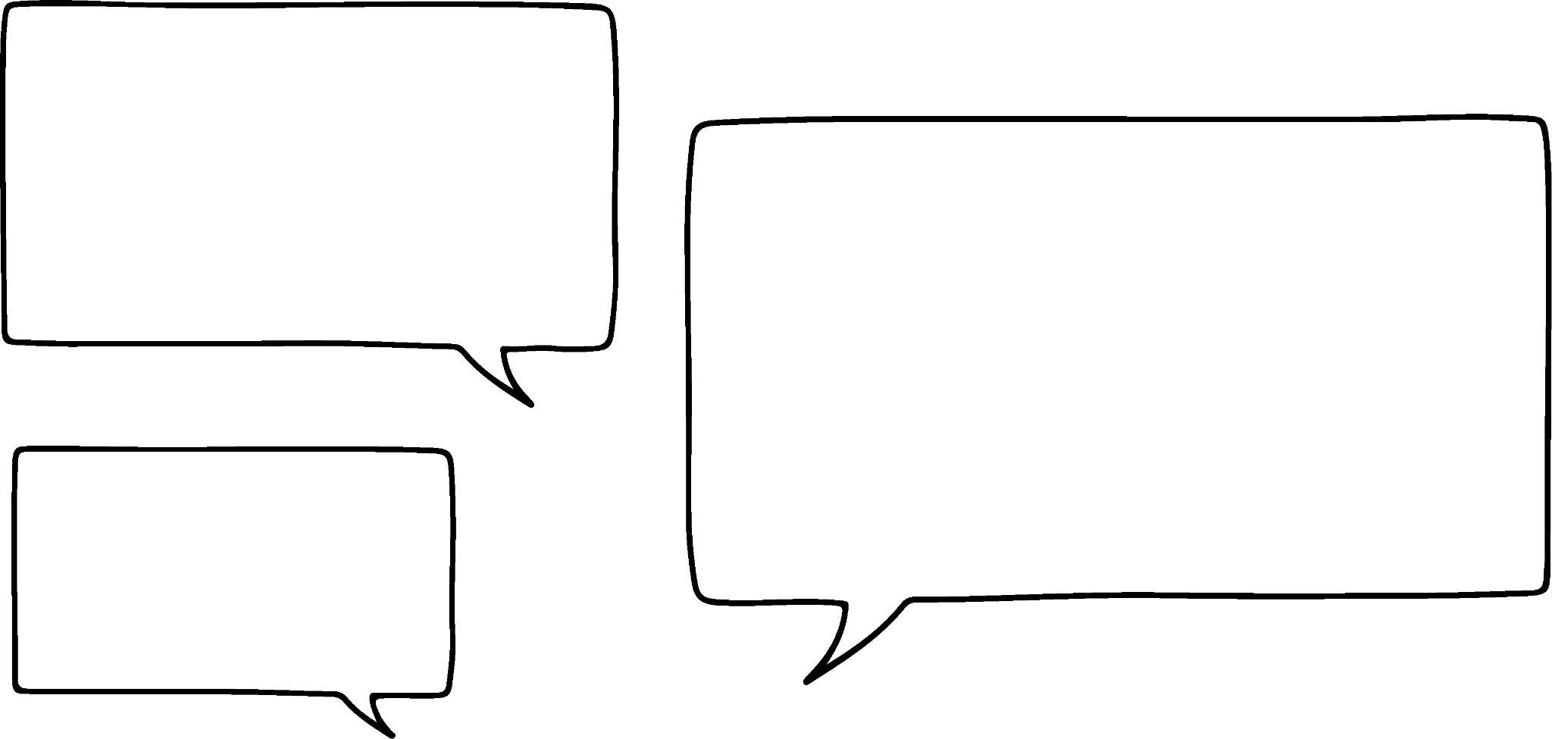

Checking understanding of enlargement
This object was enlarged by a scale factor of 3 to create the image.
Alex measures the lengths on the object.
He is about to measure the lengths on the image. What should he expect?
12 cm
Each length on the image will be 3 times its corresponding length on the object.
× 3
15 cm
9 cm
4 cm
× 3
× 3
3 cm
5 cm
Alex
object
image

Slide 7

Checking understanding of enlargement
The object was enlarged by a scale factor of 3 to create the image.
Alex measures the angles on the object.
He is about to measure the angles on the image. What should he expect?
Each angle on the image will be 3 times its corresponding angle on the object.
But that would make the angles in the image sum to more than 180°. That can’t be right.
object
37°
image
Alex
Laura
53°

Slide 8
Checking understanding of enlargement
When a shape is enlarged the lengths may change but the angles do not change.
Helpful checks:
Both triangles are right-angled.
37°
Both triangles contain two acute angles.
object
The angles in each triangle sum to 180°.
37°
image
53°
53°

Slide 9
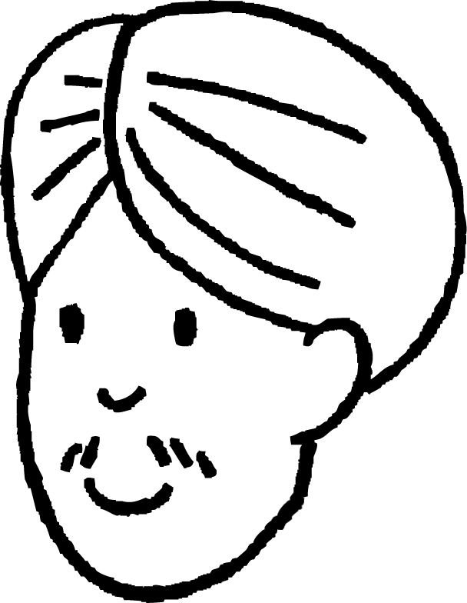
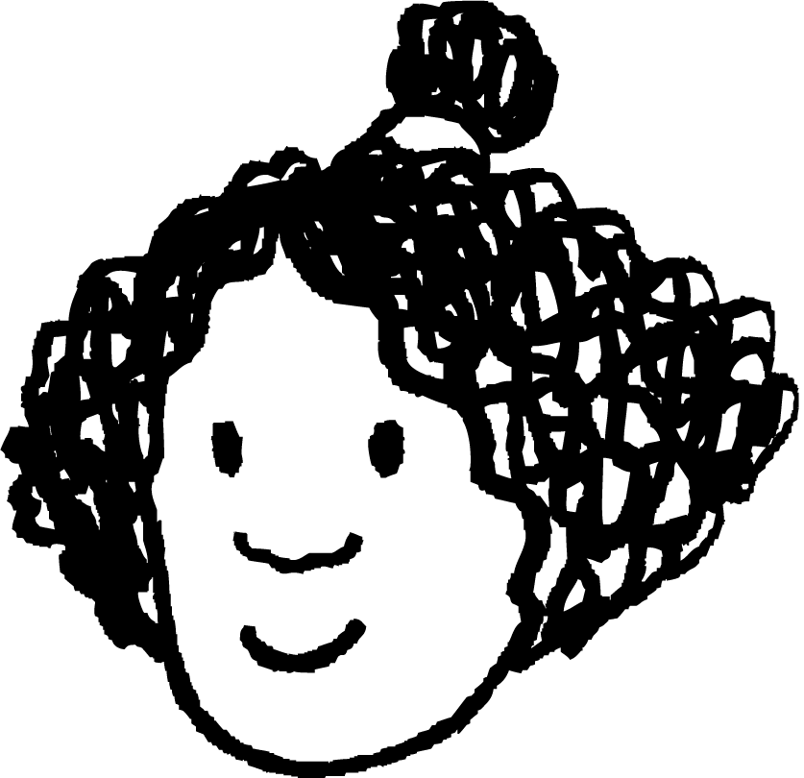
Checking understanding of enlargement
One of the shapes is an enlargement of the other.
How could the scale factor be calculated?
We could calculate the scale factor by dividing a pair of corresponding lengths.
The order of the division will depend on which shape is the object and which is the image.
10 cm
B
5 cm
A
6 cm
3 cm
Andeep
Izzy

Slide 10
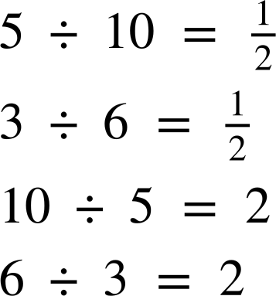
Checking understanding of enlargement
One of the shapes is an enlargement of the other.
How could the scale factor be calculated?
If A is the object and B is the image:
If B is the object and A is the image:
10 cm
B
5 cm
A
6 cm
scale factor = 2
scale factor =
3 cm

Slide 11
Checking understanding of enlargement
The object has been enlarged by a scale factor of 5 to create the image. What is the value of x?
x mm
6 mm
x = 6 × 5 = 30

Slide 12
Checking understanding of enlargement
The object has been enlarged by a scale factor of 0.5 to create the image. What is the value of x?
x°
70°
x = 70. Angle sizes are preserved during enlargement.

Slide 13
Checking understanding of enlargement
1) a) Enlarge the object by a scale factor of 3 from the point marked.
b) Use a ruler to measure all of the lengths on each shape and check that each length on the image is 3 times its corresponding length on the object.
c) Use a protractor to measure all of the angles on each shape and check that each angle on the image is equal to its corresponding angle on the object.

Slide 14
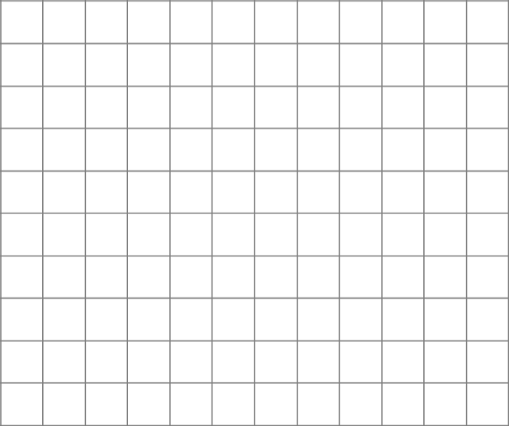

Checking understanding of enlargement
2) Jun wants to enlarge the shape by a scale factor of 2. He needs to choose the centre of enlargement carefully so that all of the image stays on the grid.
Find all the points which Jun could use for the centre of enlargement.

Slide 15
Checking understanding of enlargement
1) a) Enlarge the object by a scale factor of 3 from the point marked.
Check: the bottom left vertex of the image should be directly below the bottom right vertex of the object.

Slide 16

Checking understanding of enlargement
b) Use a ruler to measure all of the lengths on each shape and check that each length on the image is 3 times its corresponding length on the object.
Lengths may vary depending on printing.
Example of a combination of lengths:
Check:
15 ÷ 5 = 3
12 ÷ 4 = 3
9 ÷ 3 = 3
15 cm
5 cm
9 cm
3 cm
4 cm
12 cm

Slide 17
Checking understanding of enlargement
c) Use a protractor to measure all of the angles on each shape and check that each angle on the image is equal to its corresponding angle on the object.
If worksheet has been printed in proportion, angles should match those below.
Angles may vary if the proportions have not been maintained.
Check:
Angles in the image are equal to their corresponding angles in the object.
53°
15 cm
5 cm
9 cm
53°
3 cm
Additional check:
37°
53 + 90 + 37 = 180 Angles in each triangle sum to 180°.
4 cm
37°
12 cm

Slide 18
Checking understanding of enlargement
2) Jun wants to enlarge the shape by a scale factor of 2. He needs to choose the centre of enlargement carefully so that all of the image stays on the grid.
Find all the points which Jun could use for the centre of enlargement.
The image stays on the grid when using any centre of enlargement in this region.
🖇interactive demonstration

Slide 19
Checking understanding of similarity
Checking understanding of enlargement
Checking understanding of similarity

Slide 20

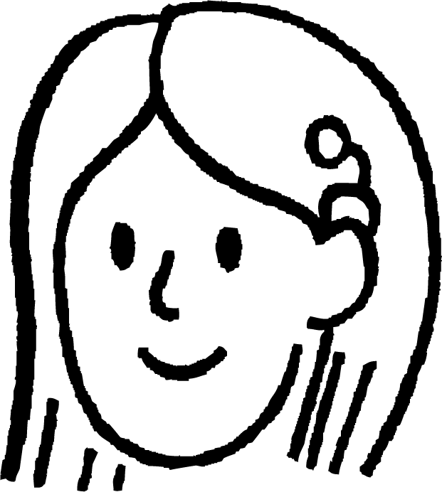
Checking understanding of similarity
Here is a photograph of Liverpool.
Sofia and Jun both copy the photograph and make it bigger.
Why does Jun’s photograph look distorted?
original photo
Sofia’s copy
Jun’s copy

Slide 21
Checking understanding of similarity
When an object is enlarged to create an image, the object and the image are similar.
Two shapes are similar if their lengths are in the same proportion.
The shapes are similar because…
the ratios between the lengths in each shape are equivalent.
8
4
× 1.5
4 : 6 8 : 12
× 2
× 2
6
12
× 1.5

Slide 22
Checking understanding of similarity
When an object is enlarged to create an image, the object and the image are similar.
Two shapes are similar if their lengths are in the same proportion.
The shapes are not similar because…
the ratios between the lengths in each shape are not equivalent.
8
4
× 1.5
4 : 6 8 : 6
× 2
× 1
6
6
× 0.75

Slide 23
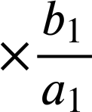
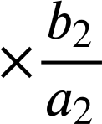

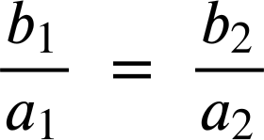
Checking understanding of similarity
Are all circles similar?
How could you justify your answer?
The radii of a circle is the same length in every direction.
b₁
a₁
So the multipliers between corresponding radii will be equal.
a₂
b₂
Jacob

Slide 24
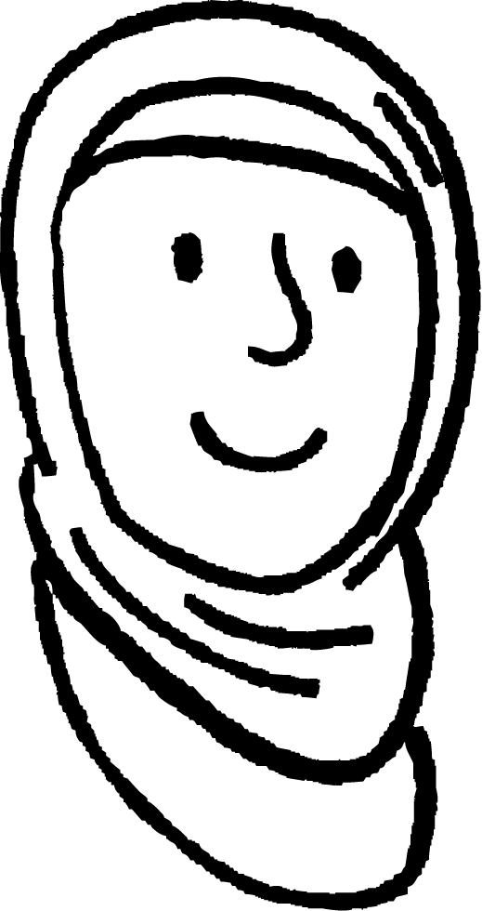
Checking understanding of similarity
Are all circles similar?
How could you justify your answer?
The radii of a circle is the same length in every direction.
So the multipliers between radii within each circle are equal. They are always 1.
b₁
a₁
× 1
a₂
× 1
b₂
Aisha

Slide 25
Checking understanding of similarity
Are all circles similar?
How could you justify your answer?
The ratio between the diameter and the circumference in every circle is always the same.
× π
× π
Jun

Slide 26
Checking understanding of similarity
Two shapes are similar if their lengths are in the same proportion. The orientations of the shapes may differ.
12 cm
The shapes are similar, which means…
37°
the multipliers between corresponding lengths are equal.
the ratios between the lengths in each shape are equivalent.
corresponding angles are equal.
37°
9 cm
15 cm
5 cm
4 cm
53°
9 ÷ 3 = 3 12 ÷ 4 = 3 15 ÷ 5 = 3
3 : 4 : 5 9 : 12 : 15
53°
3 cm
Angles are invariant during enlargement.

Slide 27
Checking understanding of similarity
Which shape is similar to triangle T?
9 cm
6 cm
T
11 cm
12 cm
4 cm
14 cm
3 cm
6 cm
3 cm
8 cm
2 cm
4 cm

Slide 28

Checking understanding of similarity
The two shapes below are similar. Find the missing lengths.
scale factor:
18 ÷ 12 =
13 cm
12 cm
longest side:
13 × = 19.5
5 cm
19.5 cm
shortest side:
7.5 cm
7.5 ÷ = 5
18 cm

Slide 29

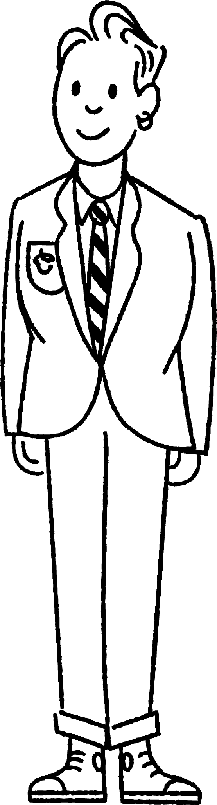
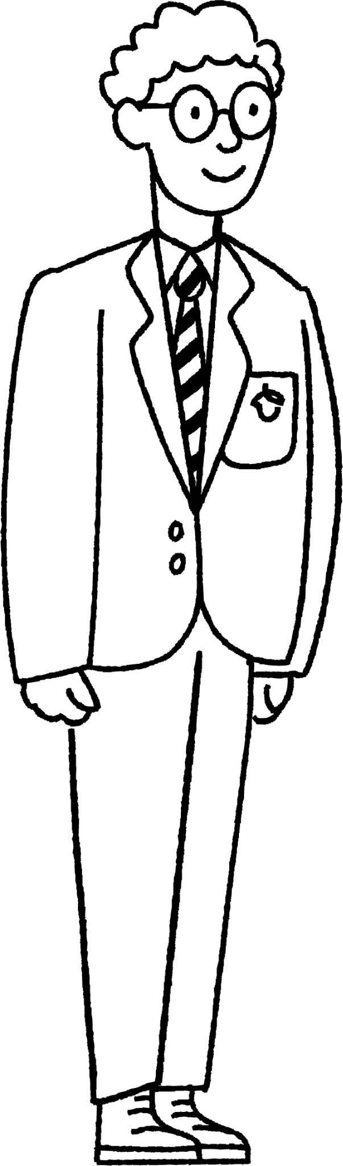


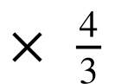
Checking understanding of similarity
Alex and Sam are estimating the height of the traffic lights on a sunny day.
How could they do this by using similar shapes?
If we know Alex’s height, then we could estimate the height of the traffic lights by measuring shadows.
4 m
?
156 cm
117 cm
3 m

Slide 30

Checking understanding of similarity
The two shapes are similar. Find the value of x.
20 ÷ 8 = x = 4 ×
= 10
Method 1 Between shapes
4 cm
Method 2 Between sides of same shape
20 cm
10 cm
4 × 2 = 8 x × 2 = 20
x = 10
x cm
8 cm
12 cm

Slide 31
Checking understanding of similarity
1) Use similarity to find the missing lengths.
a)
b)
70 inches
140 inches
?
148 cm
370 cm
?
15.25 m

Slide 32
Checking understanding of similarity
2) a) Match each triangle with its similar triangle. b) Find the scale factor between each pair of similar triangles.
29
10
5
12.5
10.5
7.5
D
A
12
C
B
14.5
13
10
20
21
34
5
G
3
4
39
F
15
E
30
15
16
8
H
36
17

Slide 33
Checking understanding of similarity
1) Use similarity to find the missing lengths.
a)
b)
70 inches
140 inches
6.1 m
148 cm
370 cm
35 inches
15.25 m

Slide 34
Checking understanding of similarity
2) a) Match each triangle with its similar triangle. b) Find the scale factor between each pair of similar triangles.
29
10
5
12.5
10.5
7.5
D
A
12
C
B
14.5
13
10
20
21
34
5
G
3
4
39
F
15
E
30
15
16
8
H
36
17

Slide 35

Checking understanding of similarity
2) a) Match each triangle with its similar triangle. b) Find the scale factor between each pair of similar triangles.
5
39
12
A
15
E
13
36
A and E
scale factor 3 or

Slide 36

Checking understanding of similarity
2) a) Match each triangle with its similar triangle. b) Find the scale factor between each pair of similar triangles.
29
10
B
D
10.5
20
21
14.5
B and D
scale factor 2 or

Slide 37
Checking understanding of similarity
2) a) Match each triangle with its similar triangle. b) Find the scale factor between each pair of similar triangles.
12.5
5
7.5
3
C
G
4
10
C and G
scale factor or

Slide 38
Checking understanding of similarity
2) a) Match each triangle with its similar triangle. b) Find the scale factor between each pair of similar triangles.
34
15
H
8
F
F
30
17
16
F and H
scale factor 2 or

Slide 39
Checking understanding of similarity
An enlargement means a change in size.
The lengths of lines may change when enlarged.
The angles inside an object do not change when enlarged.
When an object is enlarged, the image is similar.
The orientations of similar shapes may differ.

Slide 40

© Oak National Academy 2024.
Produced in partnership with Mathematics in Education and Industry.
Licensed on the Open Government Licence v3.0, except where otherwise stated. See Oak terms and conditions.

